Slide 1








Stock Price Prediction Project Workflow
Data Clean
Feature Engineering
Regression
Stock Price Data
Data Preparation
4 FE Methods
4 ML Models
Evaluation
Best (FE + Model)
Github link: https://github.com/QinglinGou/DS5500_Stock_price_prediction

Slide 2
Dataset Preparation
Features
Label
One day
Close
+
Stock data
31
Technical
Indicators
Next 1 days
Close Price
2018-01-02
2023-01-01
till now
Dimension
Reduction
1259
267
Training data
Test data

Slide 3
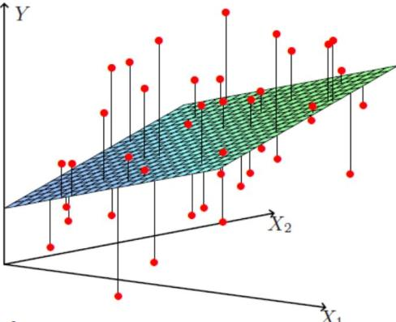
Model Selection
Linear Regression
Simplest regression model
Linear relationship
Reason
Capture general trend

Slide 4
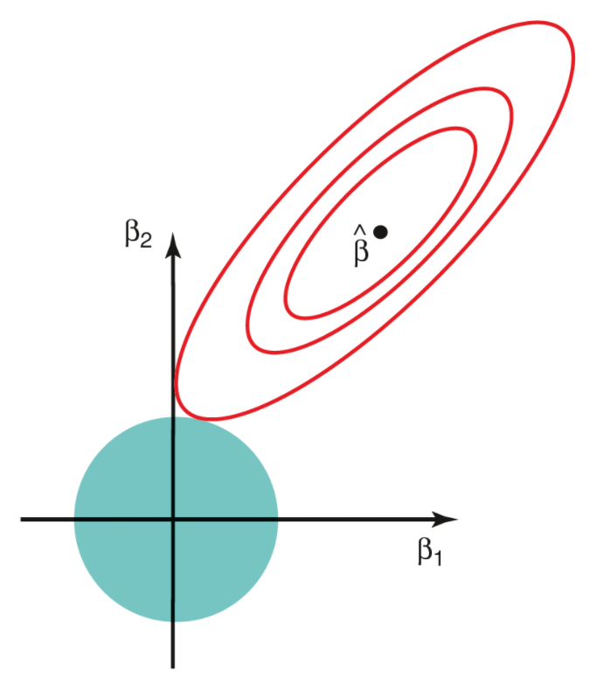
Model Selection
Lasso
Least Absolute Shrinkage and Selection Operator
Multicollinearity
Reason
Find correlations between features

Slide 5
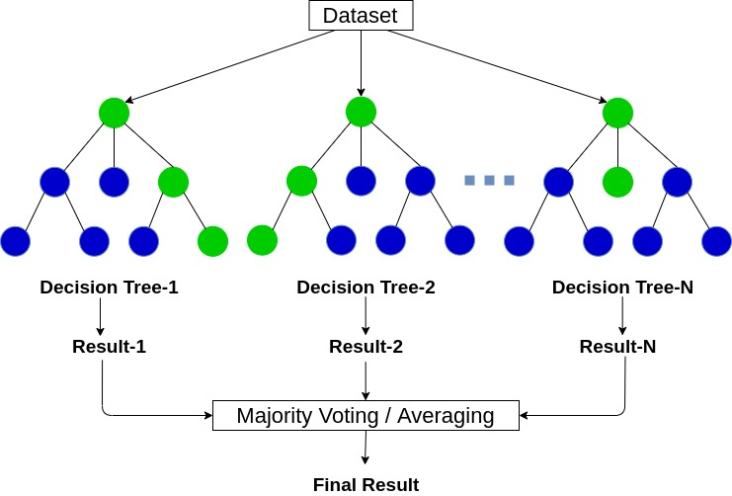
Model Selection
Random Forest
Multiple dependent decision trees
Voting / Averaging results
Reason
Handle outliers

Slide 6

Model Selection
Long Short-Term Memory (LSTM)
RNN based model with Memory Cells
Gating Mechanisms
Reason
Memory of Past Data
Handling Time Series Data

